Slide 1
Unsupervised Learning: Neighbor Embedding

Slide 2
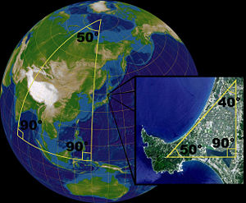
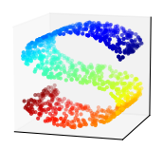
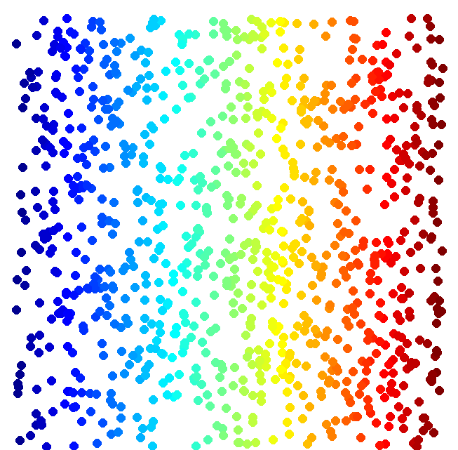
Manifold Learning
Suitable for clustering or following supervised learning

Slide 3
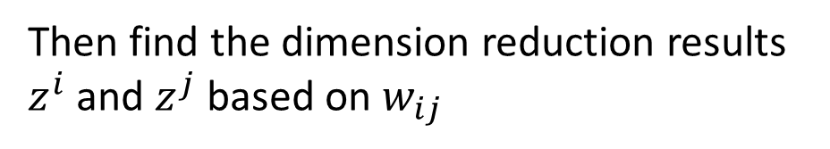

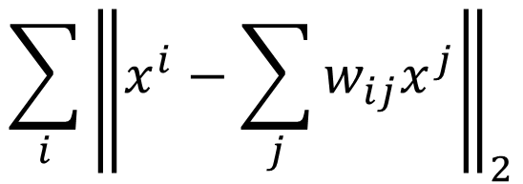

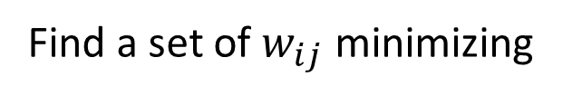
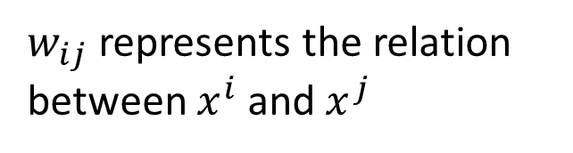

Locally Linear Embedding (LLE)
$w_{ij}$ represents the relation between $x^{i}$ and $x^{j}$
$$x^{j}$$
$$w_{ij}$$
Find a set of $w_{ij}$ minimizing
$$x^{i}$$
$$\sum_{i}{{\left\|x^{i}−\sum_{j}{w_{ij}x^{j}}\right\|}_{2}}$$
Then find the dimension reduction results $z^{i}$ and $z^{j}$ based on $w_{ij}$

Slide 4
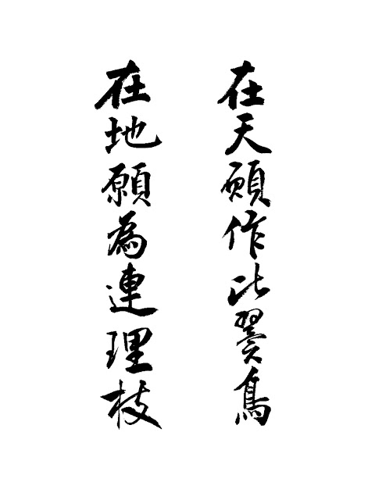
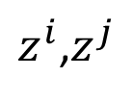
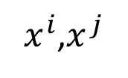


LLE
$z^{i}$,$z^{j}$
$x^{i}$,$x^{j}$
$$w_{ij}$$
$$w_{ij}$$
Source of image: http://feetsprint.blogspot.tw/2016/02/blog-post_29.html

Slide 5
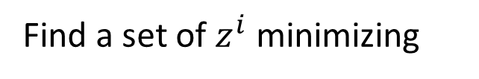




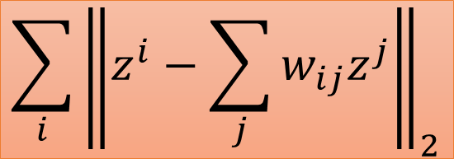



LLE
Find a set of $z^{i}$ minimizing
$$\sum_{i}{{\left\|z^{i}−\sum_{j}{w_{ij}z^{j}}\right\|}_{2}}$$
Keep $w_{ij}$ unchanged
$$x^{j}$$
$$z^{j}$$
$$w_{ij}$$
$$z^{i}$$
$$x^{i}$$
$$w_{ij}$$
Original Space
New (Low-dim) Space

Slide 6
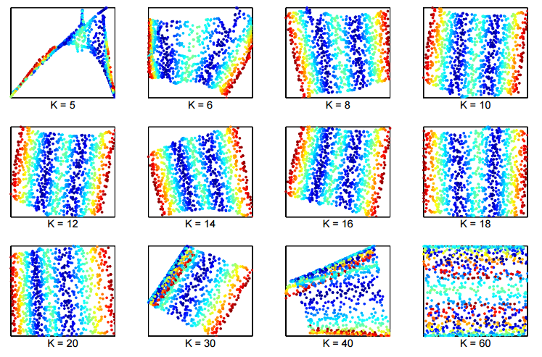
LLE
Lawrence K. Saul, Sam T. Roweis, “Think Globally, Fit Locally: Unsupervised Learning of Low Dimensional Manifolds”, JMLR, 2013

Slide 7
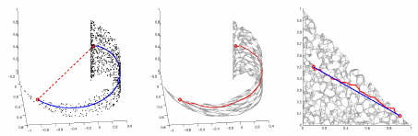
Laplacian Eigenmaps
Distance defined by graph approximate the distance on manifold
Graph-based approach
Construct the data points as a graph

Slide 8
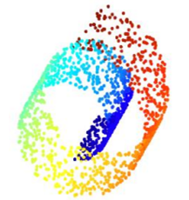
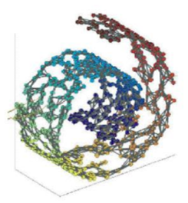


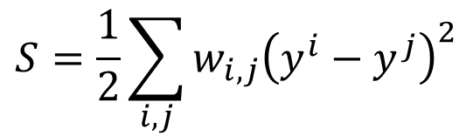




Laplacian Eigenmaps
similarity
$$w_{i,j}=$$
If connected
0
otherwise
Review in semi-supervised learning: If $x^{1}$ and $x^{2}$ are close in a high density region, ${\hat{y}}^{1}$ and ${\hat{y}}^{2}$ are probably the same.
$$L=\sum_{x^{r}}{C\left(y^{r},{\hat{y}}^{r}\right)}$$
$$+λS$$
As a regularization term
$$S=\frac{1}{2}\sum_{i,j}{w_{i,j}{\left(y^{i}−y^{j}\right)}^{2}}$$
$$=y^{T}Ly$$
L: (R+U) x (R+U) matrix
S evaluates how smooth your label is
Graph Laplacian
$$L=D−W$$

Slide 9
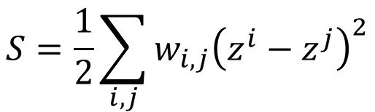

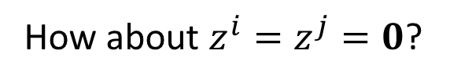
Laplacian Eigenmaps
Dimension Reduction: If $x^{1}$ and $x^{2}$ are close in a high density region, $z^{1}$ and $z^{2}$ are the close to each other.
$$S=\frac{1}{2}\sum_{i,j}{w_{i,j}{\left(z^{i}−z^{j}\right)}^{2}}$$
Any problem?
How about $z^{i}=z^{j}=0$?
Giving some constraints to z:
If the dim of z is M,
Span{z¹, z², … z^{N}} = R^{M}
Spectral clustering: clustering on z
Belkin, M., Niyogi, P. Laplacian eigenmaps and spectral techniques for embedding and clustering. Advances in neural information processing systems . 2002

Slide 10
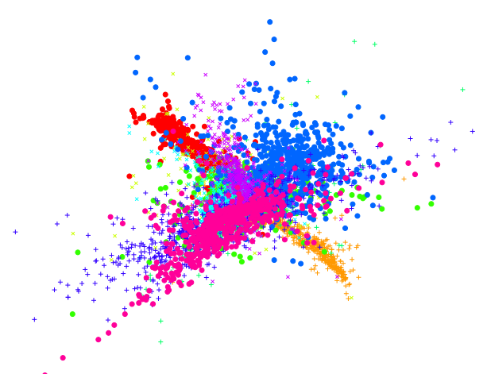
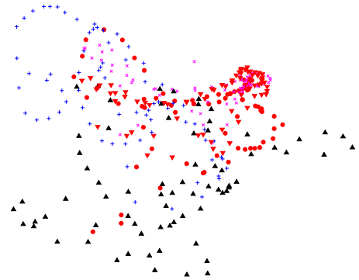
T-distributed Stochastic Neighbor Embedding (t-SNE)
Problem of the previous approaches
Similar data are close, but different data may collapse
LLE on MNIST
LLE on COIL-20
Notes:
http://www1.cs.columbia.edu/CAVE/software/softlib/coil-20.php

Slide 11
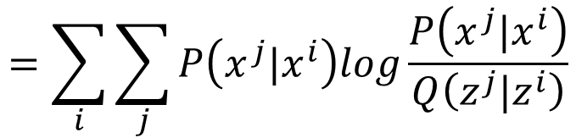
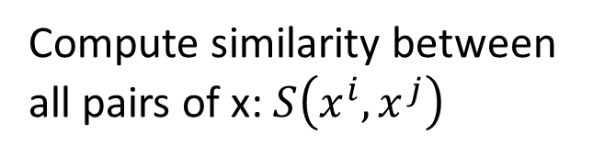
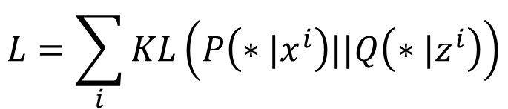
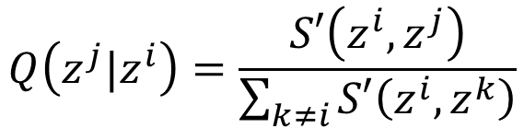
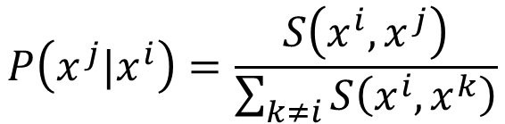
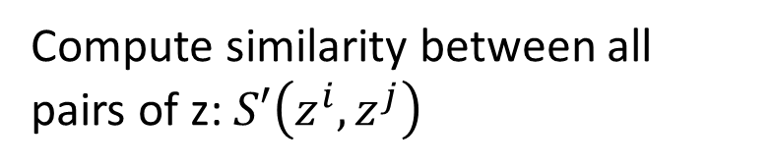
t-SNE
x
z
Compute similarity between all pairs of x: $S\left(x^{i},x^{j}\right)$
Compute similarity between all pairs of z: $S′\left(z^{i},z^{j}\right)$
$$P\left(x^{j}|x^{i}\right)=\frac{S\left(x^{i},x^{j}\right)}{\sum_{k≠i}{S\left(x^{i},x^{k}\right)}}$$
$$Q\left(z^{j}|z^{i}\right)=\frac{S′\left(z^{i},z^{j}\right)}{\sum_{k≠i}{S′\left(z^{i},z^{k}\right)}}$$
Find a set of z making the two distributions as close as possible
$$L=\sum_{i}{KL\left(P\left(∗|x^{i}\right)||Q\left(∗|z^{i}\right)\right)}$$
$$=\sum_{i}{\sum_{j}{P\left(x^{j}|x^{i}\right)log\frac{P\left(x^{j}|x^{i}\right)}{Q\left(z^{j}|z^{i}\right)}}}$$
Notes:
Why KL>

Slide 12
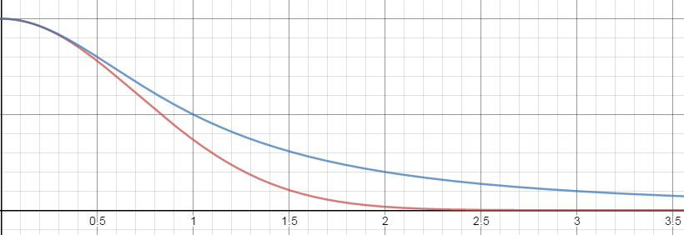
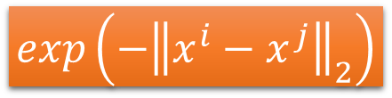


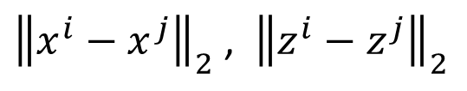

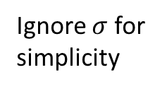


t-SNE –Similarity Measure
Ignore $σ$ for simplicity
SNE:
$$S\left(x^{i},x^{j}\right)$$
$$S′\left(z^{i},z^{j}\right)=exp\left(−{\left\|z^{i}−z^{j}\right\|}_{2}\right)$$
$$=exp\left(−{\left\|x^{i}−x^{j}\right\|}_{2}\right)$$
t-SNE:
$$S′\left(z^{i},z^{j}\right)=1/{1+{\left\|z^{i}−z^{j}\right\|}_{2}}$$
$$1/{1+{\left\|z^{i}−z^{j}\right\|}_{2}}$$
$$exp\left(−{\left\|x^{i}−x^{j}\right\|}_{2}\right)$$
${\left\|x^{i}−x^{j}\right\|}_{2}$ , ${\left\|z^{i}−z^{j}\right\|}_{2}$

Slide 13
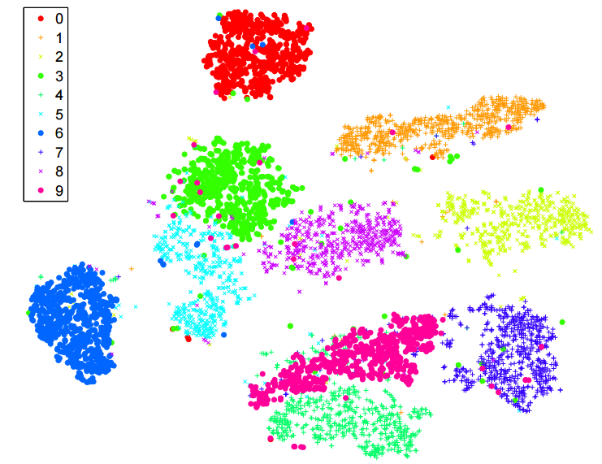
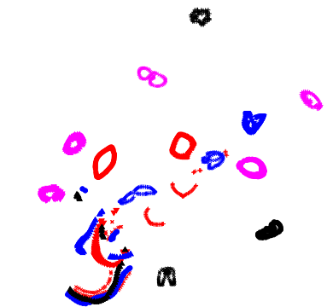
t-SNE
Good at visualization
t-SNE on MNIST
t-SNE on COIL-20
Notes:
http://www1.cs.columbia.edu/CAVE/software/softlib/coil-20.php

Slide 15
To learn more …
Locally Linear Embedding (LLE): [Alpaydin, Chapter 6.11]
Laplacian Eigenmaps: [Alpaydin, Chapter 6.12]
t-SNE
Laurens van der Maaten, Geoffrey Hinton, “Visualizing Data using t-SNE”, JMLR, 2008
Excellent tutorial: https://github.com/oreillymedia/t-SNE-tutorial

